Slide 1
Chronic Effects of Neurotrauma Consortium
In response to President Obama’s call for a National Research Action Plan (NRAP) in 2013, the Departments of Defense and Veterans Affairs funded a nationwide research consortium to study the short- and long-term effects of concussions sustained during deployment on service members and Veterans.
30+ Universities, 12 VA’s, 3 DoD sites and 3 Institutes
Five-year, $62.2 million award begun in October 2013.
CENC also partners with NIH, NINDS, NCAA and NFL research groups to jointly study civilian, sports and combat concussions.
CENC.RTI.ORG
Notes:
I did some edits on the first paragraph (RDA)

Slide 2
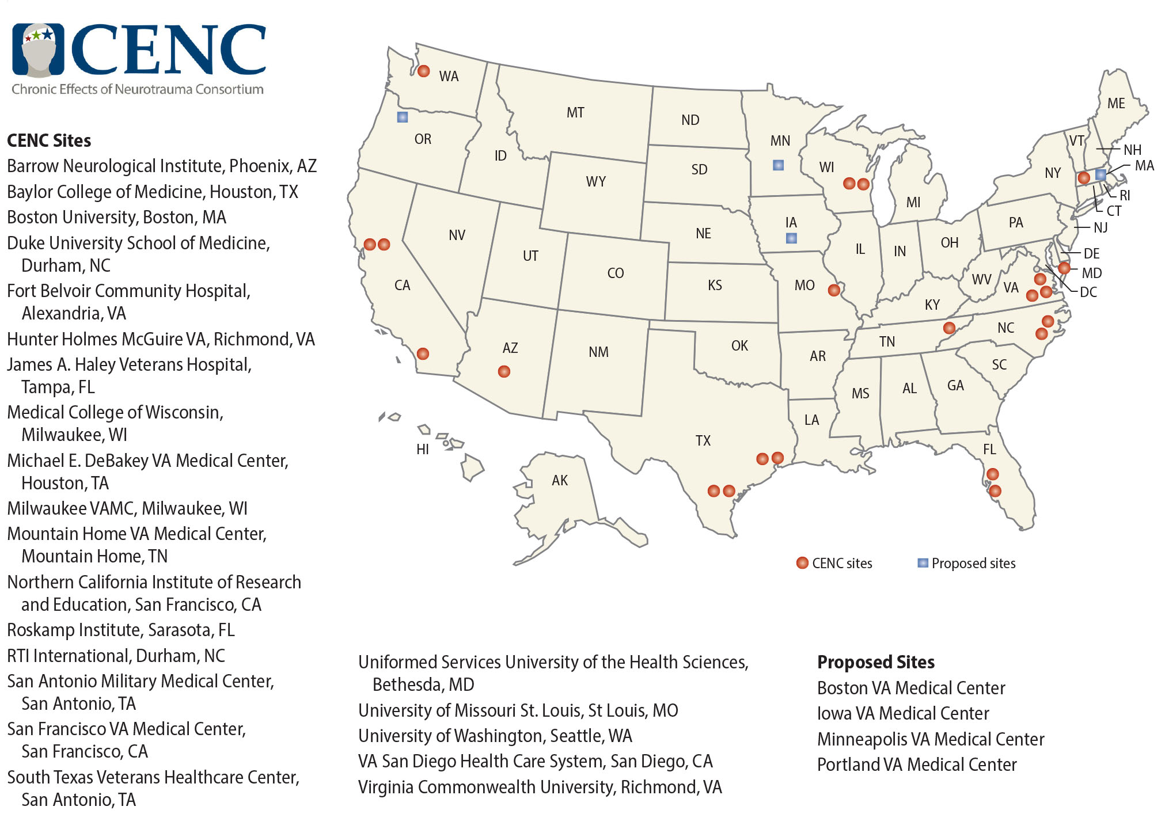

Slide 3
CENC Cores & Studies Timeline
Coordinating Center
Neuroimaging
Neuropathology
Biorepository
Approval
Data Management & Statistics
Initiation of Activities
Longitudinal Cohort Study
First Human Subject
Projected Initiation
Tau Conformation
ADAPT
Projected Completion
Otolith Dysfunction
DTI Standardization
Epidemiology
Vestibular Systems & Cognitive Adaptation
Novel White Matter Imaging Diagnosis
Neurobiology of Veterans Exposed to Blast
Visual Sensory Impairments and mTBI
Correlates of Neurodegeneration
CENC PRP RFAs
Sept. 2013
Sept. 2014
Sept. 2015
Sept. 2016
Sept. 2017
Sept. 2018
Notes:
CENC currently executes 11 studies and 4 integrated research cores
27 Participating Intuitions coordinated through VCU.
Studies in grey are newly approved by the government steering committee and pending concurrence from Senior Leadership (detailed in a few slides)
These include a data management core, biostatistics core, bio-repository, neuropathology core, and neuroimaging core.
The neuropathology core is a collaboration between Dr. Dan Perl, USUHS, and Dr. Ann McKee, Boston University and Boston VA.
Consortium studies leverage formerly funded efforts to better focus new studies and maximize scientific output.
The consortium’s longitudinal study was developed using lessons learned from an FY07 CDMRP-managed effort to the study PI, Dr. William Walker.
E.g. Consortium has brought on Dr. Christine MacDonald, University of Washington, formerly at Washington University, to collect early-phase chronic assessment data on subjects that were part of a landmark in-theater study led by Dr. David Brody (CDMRP managed FY07 and FY09 efforts). This will enable us to get data on outcome progress from a clinically verified TBI injury.

Slide 4
Current Budget and Study Break Down
Neuropathology
Core 4.5%
Otolith Dysfunction (Akin) 2.6%
Neuroimaging Core 8.6%
DTI Standardization 3.5%
Structural & Functional (Taber) 6.1%
Vestibular (Klier) 1.1%

Slide 5
CENC: DoD and VA Budget Breakdown ($62.1M)

